Slide 1
ATTENDANCE MANAGER
MOBILE APPLICATION & WEBSITE
V. BHARATH(107218504035)
P. RAVI KIRAN(107218504039)

Slide 2
CONTENTS
Objective
Hardware Requirements
Modules
UML Diagrams
Database Tables
Coding Features
Screenshots
Conclusion
Future Updates

Slide 3
OBJECTIVE
In this project, we create a mobile application and a website to manage a student’s attendance.
The mobile application we create will be used to take the attendance.
The website will be used to view the data of the student.

Slide 4


HARDWARE REQUIREMENTS
MOBILE APPLICATION
WEBSITE

Slide 5
MOBILE APPLICATION
ANDROID PIE AND ABOVE
4GB RAM
100MB FREE SPACE
INTERNET CONNECTION
FINGERPRINT READER

Slide 6
WEBSITE
4GB RAM
INTEL i3 PROCESSOR
BROWSER
INTERNET CONNECTION

Slide 7
MODULES
LOGIN
SEND MESSAGE
VIEW
UPDATE

Slide 8
LOGIN
There are 3 login priorities, that is :-
1. Admin(Only through website) 2. Teacher(Used in both application and website) 3. Student(Only through website)

Slide 9
ADMIN
This module will be used to Add Teacher and Student data into the database.
The Teacher data consists of the following data :- Name of the Teacher, Designation, Department, Address, Email, Password, Phone Number.
The Student data consists of the following data :- Name of the Student, Roll Number, Semester, Course, Parent Details, Parent Contact, Student Contact, Email, Password.

Slide 10
Teacher
Teacher(Application) The Teacher logs into the phone application, then updates the information about the student’s attendance data in the database.
Teacher(Website) The Teacher logs into the website to view the data of every student. The Teacher can also download the attendance data of each student separately.

Slide 11
STUDENT
The Student logs into the website to view his personal day-to-day attendance data.

Slide 12
SEND MESSAGE
After the Teacher logs into the phone application, and starts taking the attendance, the database is updated.
If the student is present in the class the database is updated.
If the student is not present in the class i.e., if the student is absent, then the teacher has the option to send a text stating that the student is not present in the class. The teacher can either choose to send the message to the parents or not.

Slide 13
VIEW
Teacher The Teacher can view the students of the class of the particular semester. Teacher can view individual student data. Teacher can download the individual student’s attendance data and calculate the percentages.
Student The Student can view his/her own personal day-to-day attendance data.

Slide 14
UPDATE
Teacher after logging into the mobile application will select course, and then select semester, and then select the subject for which he is taking the attendance.
After taking the attendance the data is uploaded into the database.

Slide 15
UML DIAGRAMS
ER DIAGRAM
DATA FLOW DIAGRAM
USECASE DIAGRAM

Slide 16
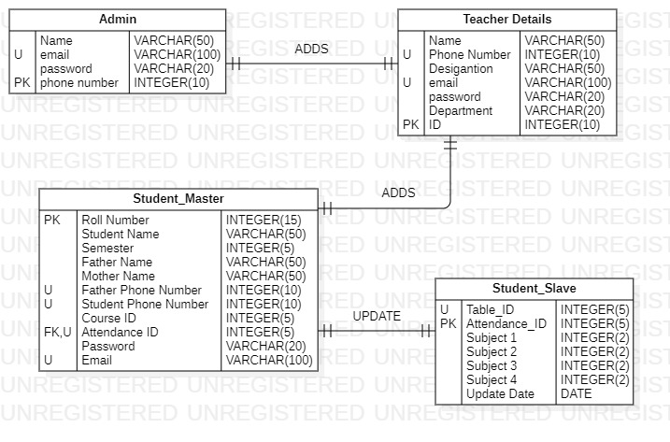
ER DIAGRAM

Slide 17
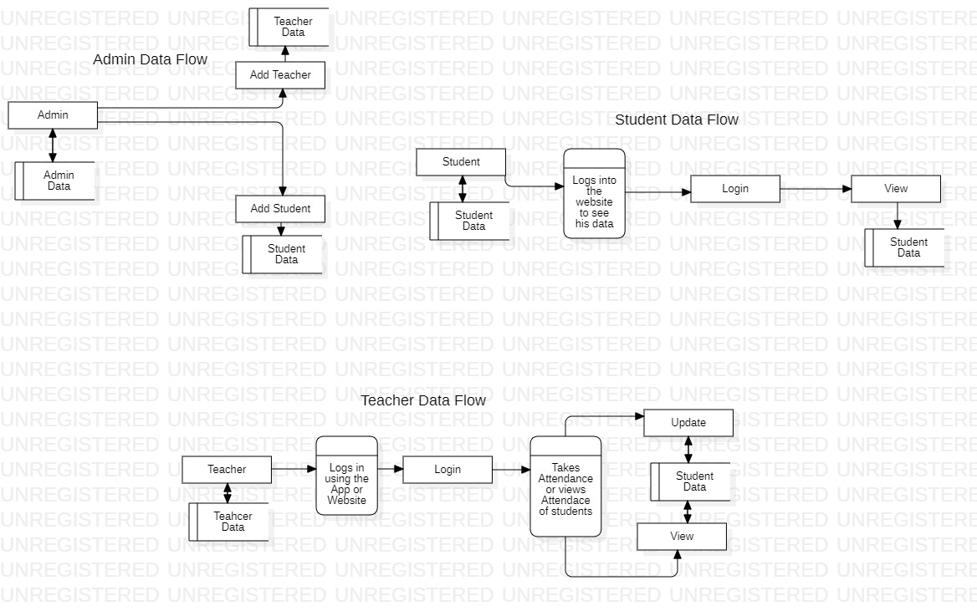
DATAFLOW DIAGRAM

Slide 18
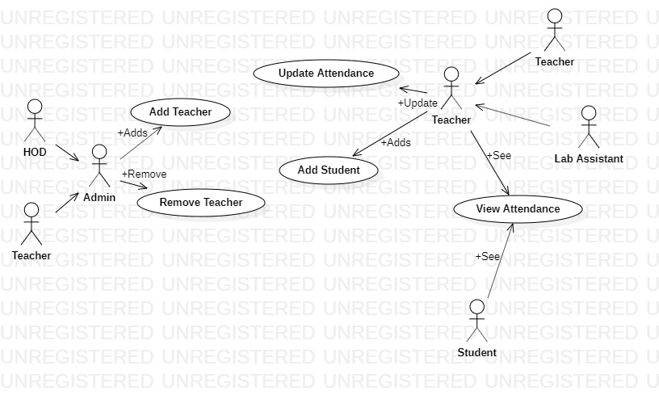
USECASE DIAGRAM

Slide 19

DATABASE TABLES
ADMIN
TEACHER DETAILS
STUDENTS DETAILS
STUDENT ATTENDANCE DETAILS

Slide 20
CODING FEATURES
The following coding languages are being used to develop the application and the website :-
1. Android Studio 2. Node.js 3. HTML 4. JavaScript

Slide 21
ANDROID STUDIO
We use android studio to develop the mobile application.
Android Studio is the official integrated development environment for Google's Android operating system, built on Jet Brains IntelliJ IDEA software and designed specifically for Android development. It is available for download on Windows, macOS and Linux based operating systems.

Slide 22
NODE.JS
It is used to write the REST API.
REST is an acronym for Representational State Transfer. It is web standards architecture and HTTP Protocol. The REST architectural style describes six constraints.
RESTful applications use HTTP requests to perform four operations termed as CRUD (C: create, R: read, U: update, and D: delete). Create and/or update is used to post data, get for reading/listing data, and delete to remove data.
RESTful is composed of methods such as; base URL, URL, media types, etc.

Slide 23
HTML
This is used to create the basic layout of the webpage which can be styled with the usage of stylesheets.
Hypertext Markup Language is the standard markup language for documents designed to be displayed in a web browser. It can be assisted by technologies such as Cascading Style Sheets and scripting languages such as JavaScript.

Slide 24
JAVASCRIPT
JavaScript, often abbreviated as JS, is an interpreted programming language that conforms to the ECMAScript specification. JavaScript is high-level, often just-in-time compiled, and multi-paradigm. It has curly-bracket syntax, dynamic typing, prototype-based object-orientation, and first-class functions.
We use JavaScript to communicate with the database i.e., send and retrieve data from the database.

Slide 25

CONCLUSION
After the completion and deployment of this application the tedious process of taking the attendance is simplified.
The teacher does not have to carry a register around for this purpose.
The student can view his/her attendance anywhere at anytime so as to know whether he has adequate percentage or not.

Slide 26
FUTURE UPDATES
In the future updates we plan to :-
Add the option to “LOG IN USING GMAIL” or “LOG IN USING FACEBOOK”.
Edit attendance data from the website.
Improve the Security.
Able to download the entire class’s attendance on one click.
Add the forgot password module.

Slide 27
Thank You

